Slide 1
LifeTiles : A Healthier way
PROTOTYPING-INTERACTIVE SYSTEM
27th Mar 2024
Alka Kumari

Slide 2
Concept
The concept of project is to make health-related cubes that captures healthy tasks throughout the day.
The cubes are tap-able and has motion sensors.
A user also has a choice of connecting the cubes to an application on a phone.
The cubes can be rearranged as per user’s priority on a particular day.
Once all of the tasks for a day has been achieved, the cubes shall turn green indicating the accomplishment.

Slide 3
Motive
The motive is - “not to be dependent on smart watch or cell phones”.
Keeping track of daily healthy habits without really keeping a track.
Connecting to an app only if user wants to keep track of their healthy habits and see a summary over multiple devices.

Slide 4
LifeTiles Cubes
01
02
04
03
Water
Excersise
Consume 8 glasses of water
30 minutes each indoor & outdoor
03
Socialialising
Meditate
Connecting with your friends & family as a daily habit
Practice meditation as a mental workout
05
Hours of Sleep
Recommended 8 hours of sleep

Slide 5
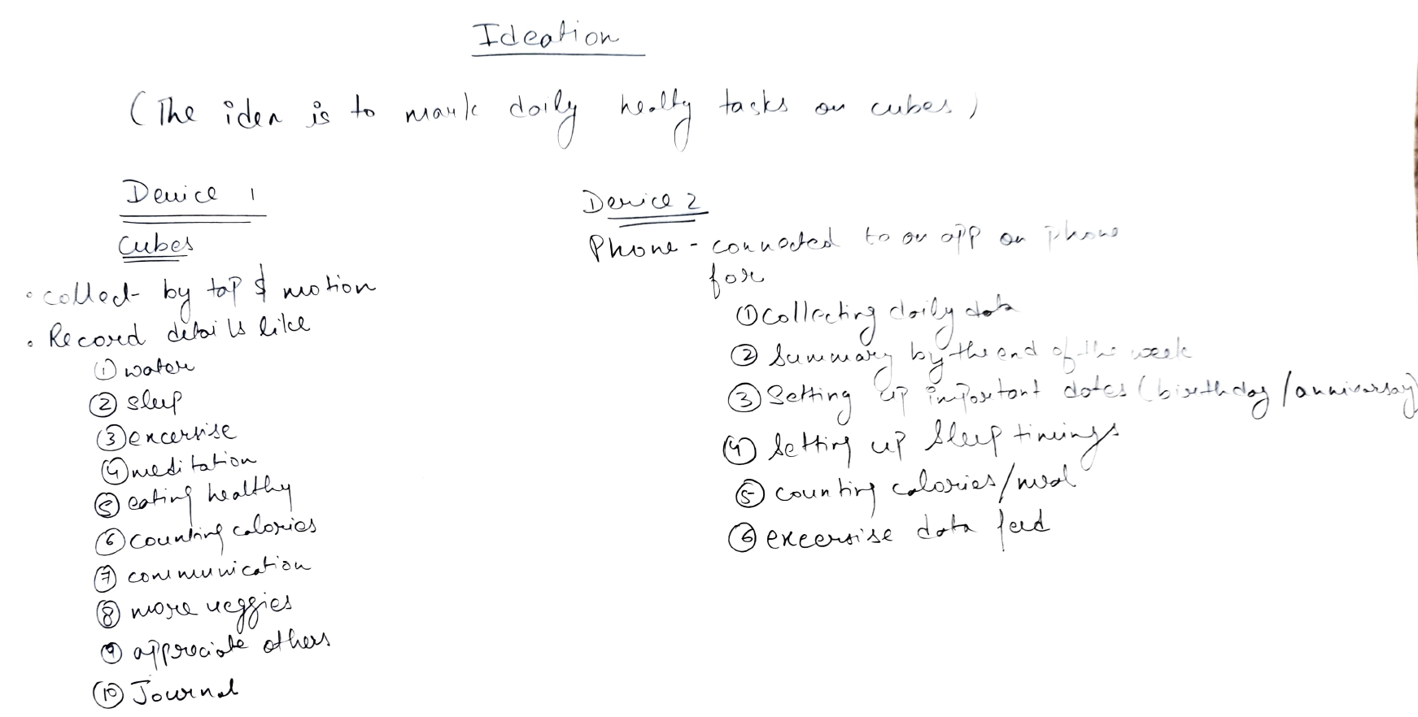
IDEATION

Slide 6
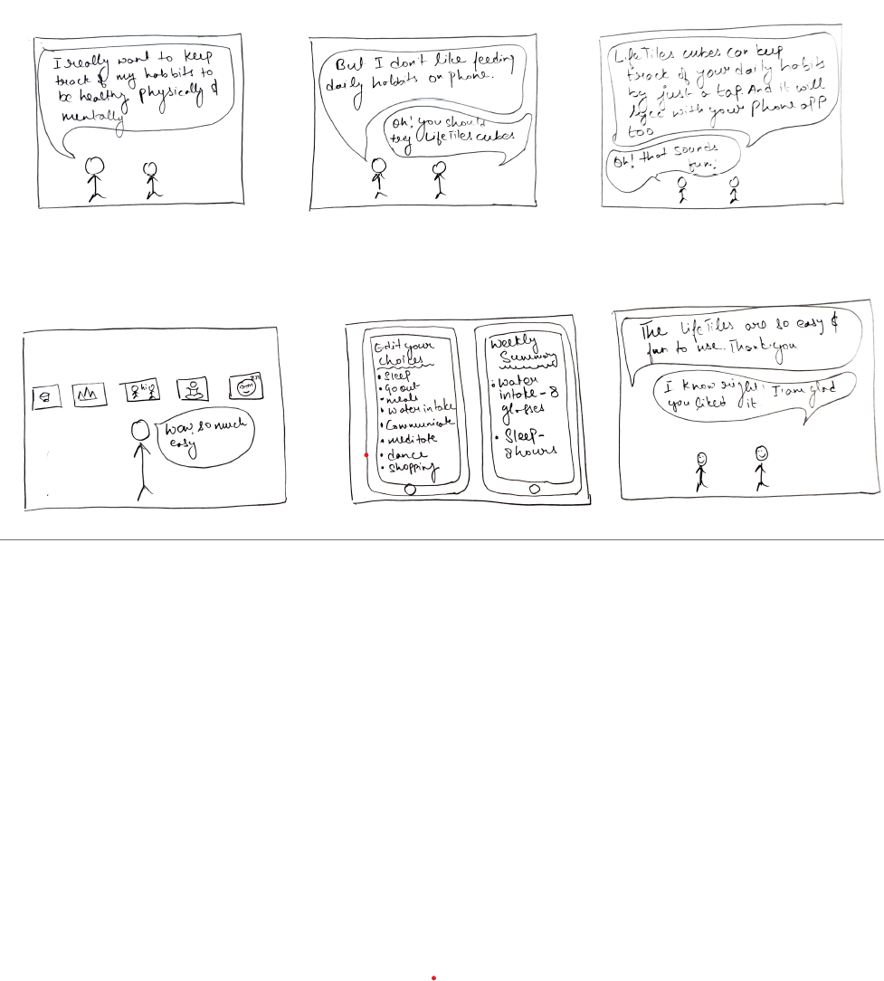
STORYBOARDING

Slide 7
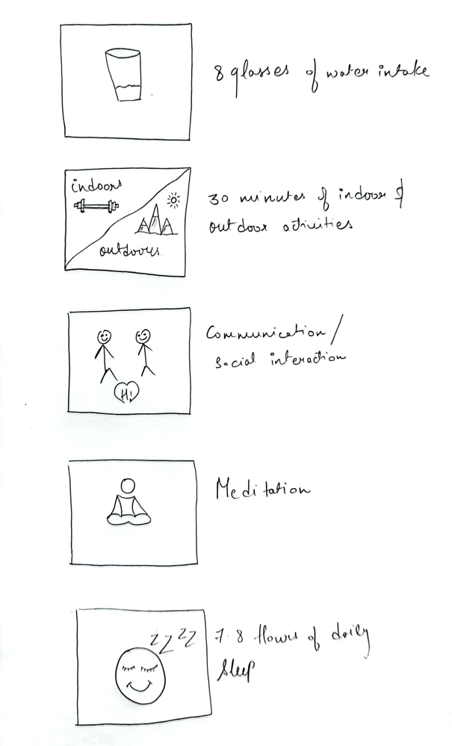
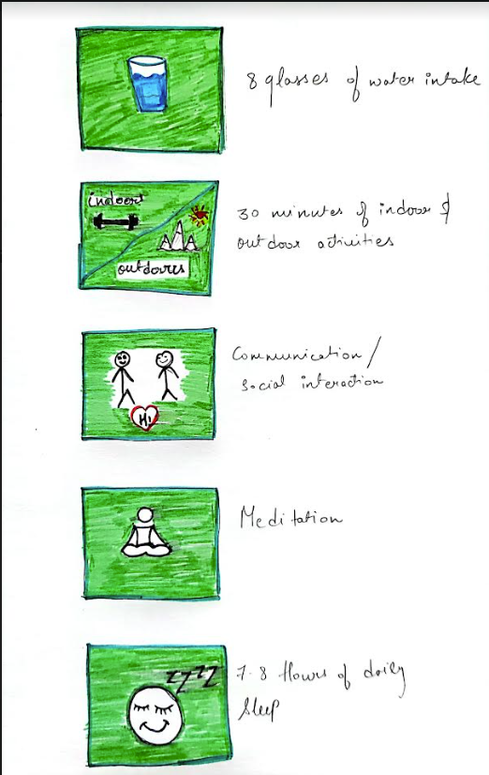


From This
The Process
To That

Slide 8
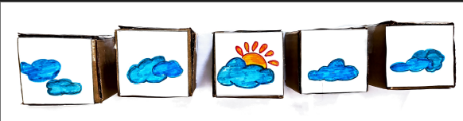
Wakey-Wakey
When the cubes register a gesture from a person, they shall wake up displaying a morning sun.

Slide 9
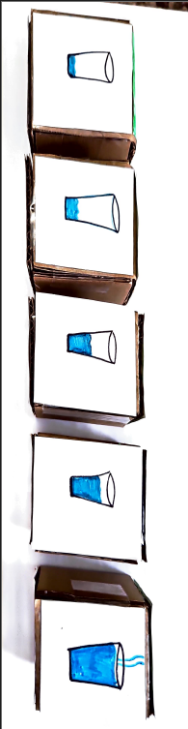
Task 01: Consuming 8 glasses of water
For this specific task, a user will tap 8 times to make the water intake count full.
The glass cube shall show the progress of water intake through out the day.

Slide 10
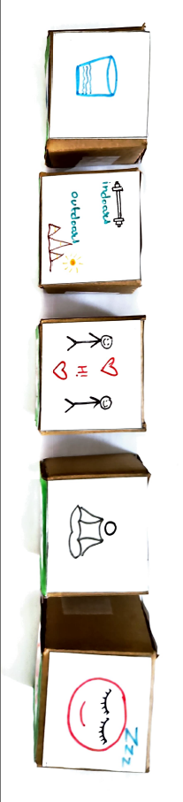
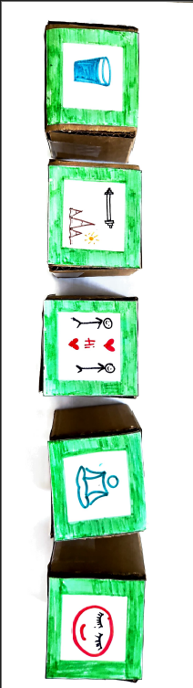
Done with the tasks for the day
Once all the tasks has been achieved for a day, all the cubes shall turn green indicating the accomplishment.

Slide 11
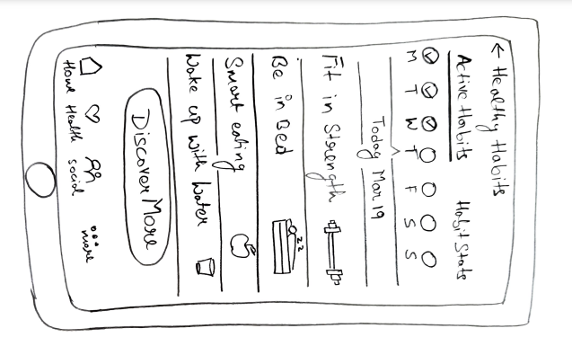
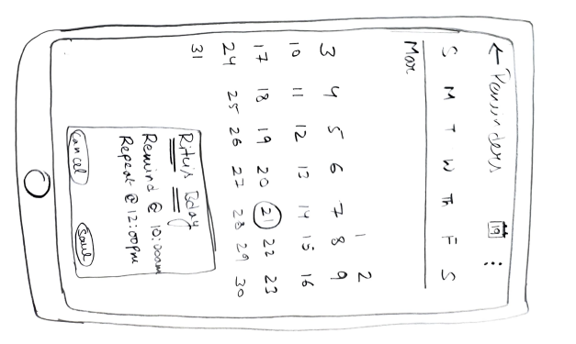
When connected to the application
When a user chooses to connect to an application on a phone:
They can select from a range of healthy habits.
A user can set up birthdays and anniversary on the calendar to connect with their friends & family.
They can also see a summary of the habits at the end of the week or month.

Slide 12
Thank You!!

